Slide 1
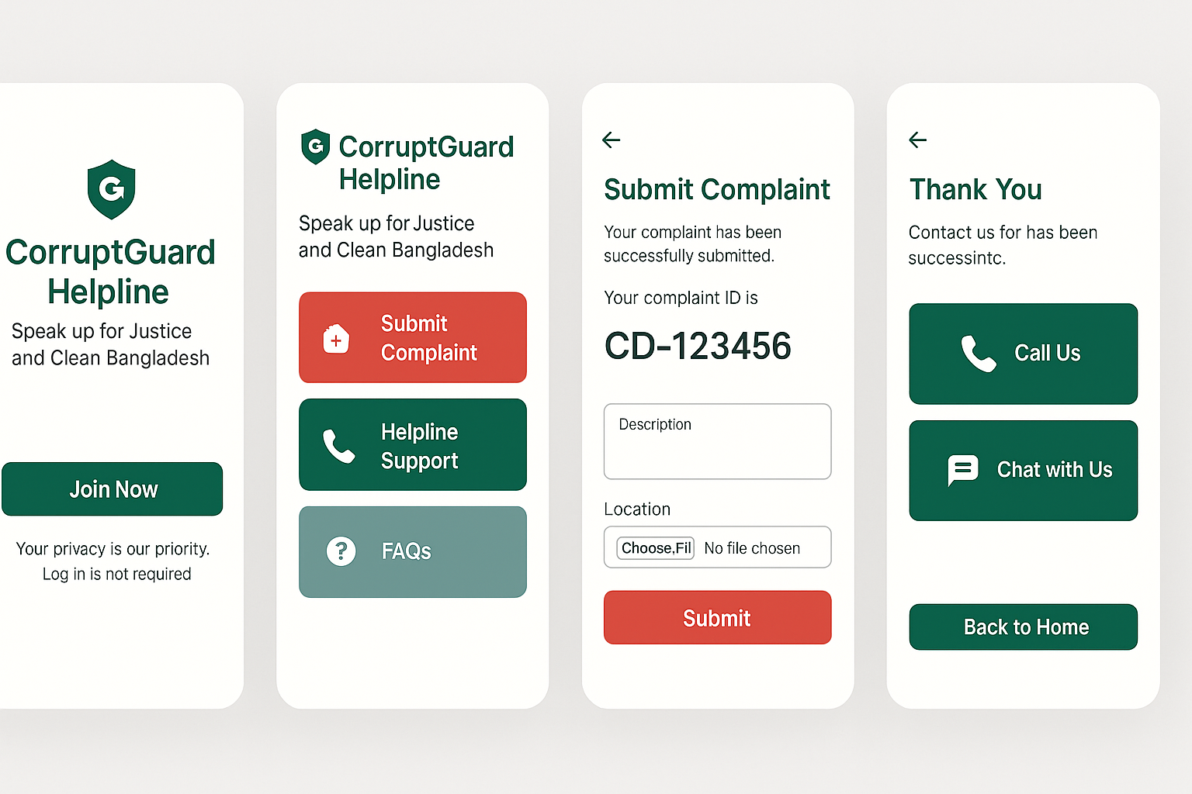
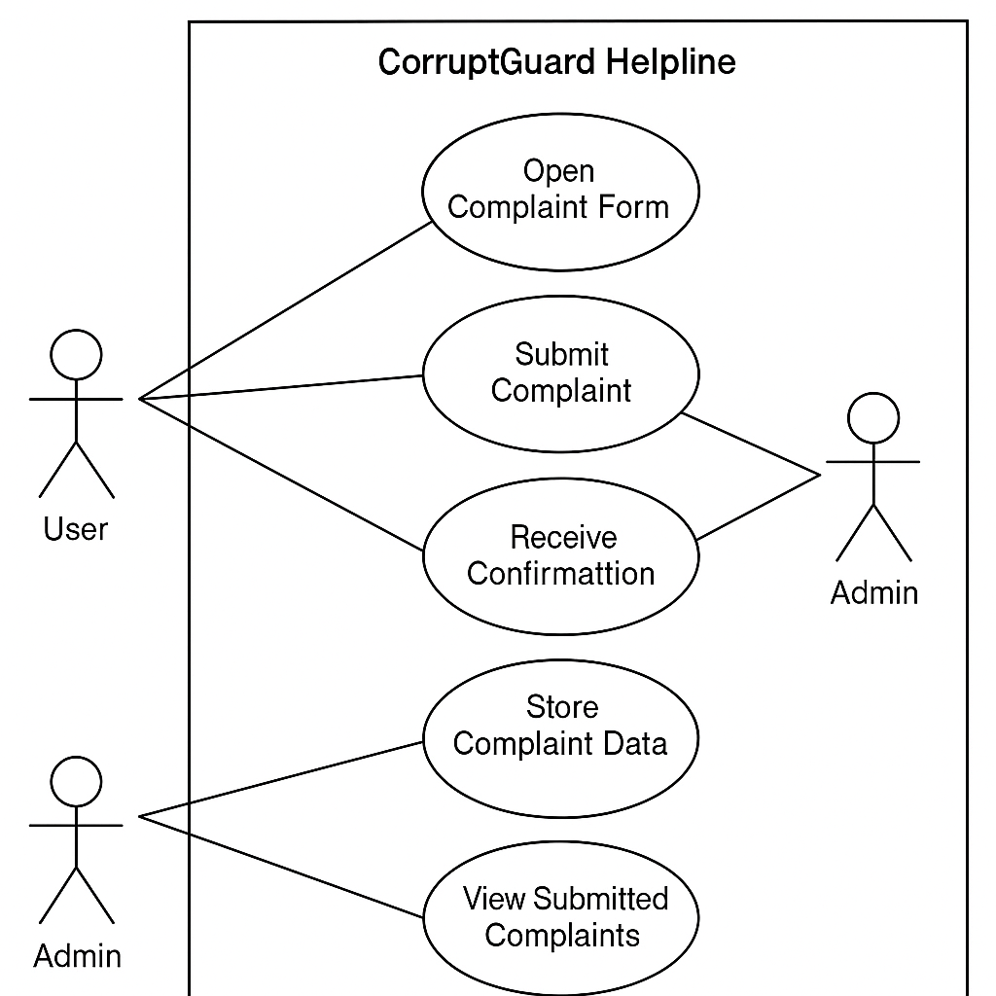
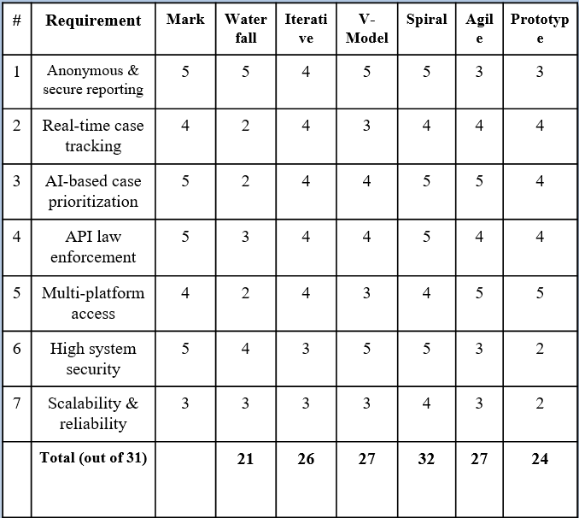
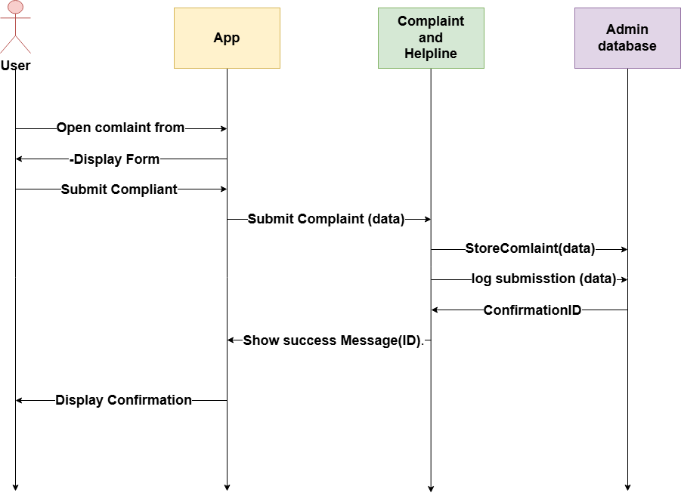
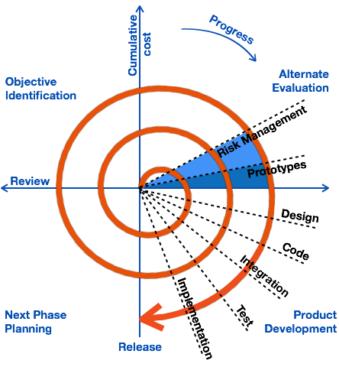
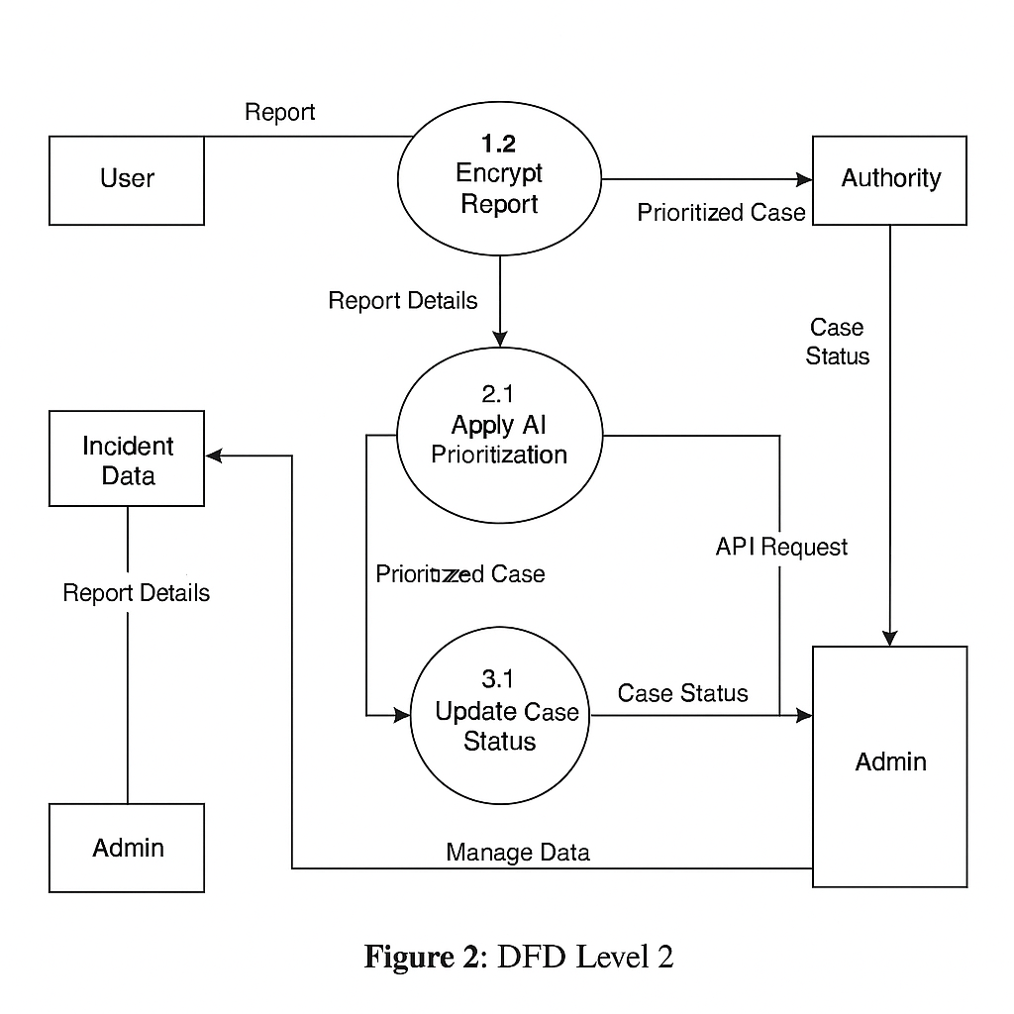
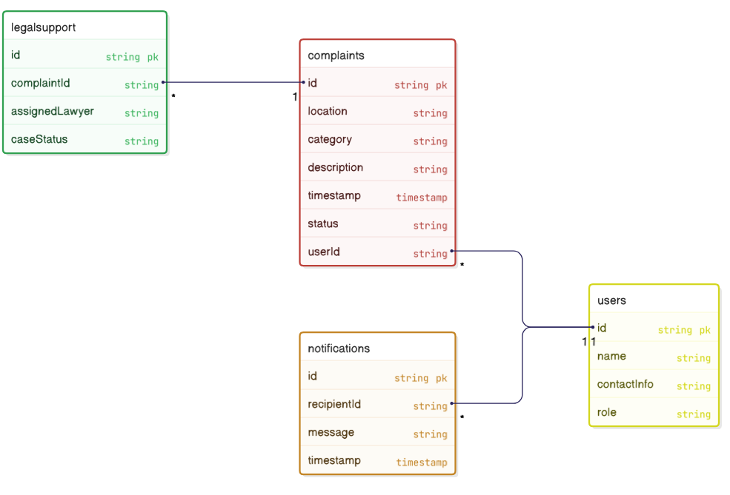
Corrupt-Guard Helpline: Speak Up for Justice and A Clean Bangladesh
Md. Jubayerul Hasan Mahin – 213902127, 2. Maharun Nesa Mahim – 213902060,
3. Robyetul Islam – 221902159, 4. Mehreen Jerin Khan – 222902019
Supervised by: Most. Rokeya Khatun
Department of Computer Science and Engineering, Green University of Bangladesh (GUB)
1. Abstract
7. Methodology
CorruptGuard Helpline is a secure and anonymous platform designed to combat corruption in Bangladesh by leveraging modern technologies such as AI, real-time mapping, and multi-channel access including web, SMS, and chatbot interfaces. It empowers everyday citizens to report unethical practices without fear of retaliation, ensuring their identity and safety are protected at all stages.
At its core, CorruptGuard is built to empower individuals to speak up against unethical behavior, bribery, abuse of power, or administrative misconduct—without fear of retaliation. The platform ensures end-to-end encryption, data anonymity, and user privacy at all stages, allowing whistleblowers to report safely and confidently.
2. Problem Domain
No Safe Reporting Channels → Fear of Retaliation Citizens often hesitate to report corruption due to a lack of secure and anonymous platforms. Without assurance of safety, fear of backlash silences victims and witnesses.
AI-Driven Prioritization – Automatically categorizes and flags high-risk or urgent cases for faster response.
Live Corruption Mapping – Visualizes complaint data geographically to identify hotspots and systemic trends in real time.
8. Software Requirement Specification
12. UML Use Case Diagram
3. Motivation
Functional Requirement | Non-Functional Requirement
Anonymous Reporting Media Uploads AI Prioritization Live Corruption Map Notifications | Security Performance Portability Maintainability Flexibility
Corruption often thrives in the shadows, silencing victims through fear and lack of access to justice. In many cases, people are unwilling to speak out due to safety concerns, lack of trust in authorities, or the absence of effective reporting mechanisms. CorruptGuard Helpline is driven by the belief that technology can bridge this gap—empowering citizens, ensuring accountability, and creating a safer, more transparent society. It aims to give voice to the voiceless and transform fear into action.
9. SDLC (Table)
4. Objective
13. UML S & C
Enable Secure & Anonymous Reporting: Develop a secure, anonymous platform for reporting corruption
Protect Whistleblowers at Every Step: Guarantee protection and privacy for whistleblowers
Offer Real-Time Case Tracking: Enable real-time tracking of complaints and case progress
Provide Access to Legal Support: Provide legal resources and support to victims of corruption
5. Literature Review
Study | Key Insight | Our Improvement
ACC Reports | Hotlines lack engagement. | Live maps + anonymity.
CPD-ODI Study | Corruption hotspots identified. | Targeted sector reporting.
Transparency Int’l | Crowdsourcing works (India/Kenya) | AI verification + multi-channel
UNODC Reports | Weak whistleblower protection. | End-to-end encryption + legal help.
World Bank Anti-Corruption Forum | Data transparency builds institutional trust. | Public dashboards for complaint outcomes.
BTRC Reports (Bangladesh) | Low digital penetration in rural areas. | SMS-based reporting option for offline users.
10. Data Flow Diagram
14. UML Class Diagram
6. Social Impact
11. Conclusion
15. References
Safe & Anonymous Reporting – Enabling individuals to speak up without fear.
Live Data & Smart Analytics – Exposing corruption in real-time through intelligent reporting.
Tech-Driven Transparency – Using technology to deter misconduct and promote integrity.
Accountability & Trust-Building – Strengthening public institutions by ensuring accountability.
Corrupt-Guard turns fear into action using tech-driven transparency. Join the movement—justice starts with your voice! Take a stand. Speak your truth. Corrupt-Guard is with you—every step of the way. In a system where silence has long protected the corrupt, your voice becomes a powerful force for change. With advanced technology, real-time data, and multi-channel access, Corrupt-Guard ensures your report reaches the right hands—securely, anonymously, and effectively. Whether you're in a city or a remote village, your courage counts. Every report you make contributes to a growing network of truth-seekers, change-makers, and everyday heroes.
[1] Anti-Corruption Commission (ACC), Annual Reports 2020–2021. https://acc.portal.gov.bd/, 2021.
[2] CPD and ODI, Decentralised Governance and Anti-Corruption in Bangladesh. https://cpd.org.bd/, 2025.
[3] CPD and ODI, Technology & Crowdsourced Transparency. https://knowledgehub.transparency.org/, 2025.
[4] UNODC, Annual Anti-Corruption Reports. https://www.unodc.org/corruption/, 2025.

